Slide 1
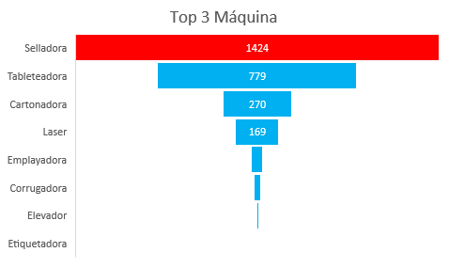
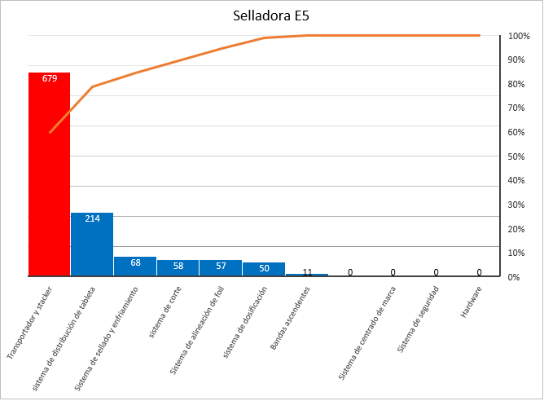
Línea E5 del 05 al 12.01.2023
minutos
Transportador y Stacker
Descripción | tiempo
Cepillos | 93
C-2 | 91
C-3 | 69
C-5 | 67
C-6 | 67
C-4 | 56
C-8 | 43
C-1 | 30
C-7 | 22
Observaciones __________________________________________________________________________________________________________________________________________________________________________________________
Acciones __________________________________________________________________________________________________________________________________________________________________________________________

